Slide 1
Phylogenetic re-evalutation of Cyclostomata using assembled transcriptomes
Copyright ©2017 BioScience Media
Ava Ghezelayagh
EEB 723

Slide 2
Vertebrata
https://en.wikipedia.org/wiki/Vertebrate
Notes:
we all know what vertebrates are

Slide 3
Vertebrata
https://www.pmfias.com/classification-vertebrata-phylum-chordata/
Notes:
Traditional taxonomic classification

Slide 4
Vertebrata
https://www.pmfias.com/classification-vertebrata-phylum-chordata/

Slide 5
Vertebrata
https://www.pmfias.com/classification-vertebrata-phylum-chordata/
Notes:
only living agnathans are cyclostomes (other agnathans are ostracoderms; armored jawless fishes)

Slide 6
Vertebrata
https://www.pmfias.com/classification-vertebrata-phylum-chordata/
Notes:
only living agnathans are cyclostomes (other agnathans are ostracoderms; armored jawless fishes)

Slide 7
Petromyzontiformes (Lampreys)
Copyright ©2017 High Desert Museum
Notes:
38 extract species
Lampetra = latin for stone licker
however, parasitic carnivorous species are best known

Slide 8
Petromyzontiformes (Lampreys)
Copyright ©2017 High Desert Museum
http://news.emory.edu/features/2018/02/lampreys/
McCauley et al. (2015)
https://msutoday.msu.edu/news/2013/bile-salts-sea-lampreys-newest-scent-of-seduction/
Notes:
have a complete brain case and a rudimentary true vertebrae

Slide 9
Myxiniformes (Hagfishes)
https://www.nytimes.com/2017/07/14/us/slime-eels-oregon.html
Notes:
76 species of hagfish, called slime eels (produce defensive slime)
Not only jawless, have no vertebrae (partial skull made of cartilage)

Slide 10
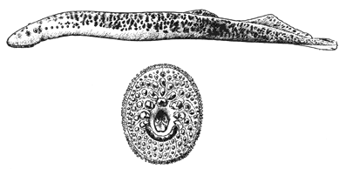
Lamprey
Cyclostomata
[Bigelow and Schroeder, 1948 p. 46.]
Hagfish
The New International Encyclopædia, v. 9, 1905, p. 441.
Notes:
is a list of morphological differences we don’t have time for

Slide 11
The problem

Slide 12
The problem:
The systematics are a mess
Notes:
that was the taxonomy, not the systematic
no consensus on cyclostome monophyly

Slide 13
Summary of hypotheses
Miyashita et al. (2019)
Notes:
taxonomic term Cyclostomata introduced in the early 1800s, but subsequent morphological studies make lampreys the true sister of gnathostomes
hagfish have fewer traits in common with jawed vertebrates than lampreys, making lampreys sister to the vertebrate crown group
molecular phylogenetic studies in the 1990s ==> monophyly of cyclostomata
deep divergence between hagfish and lampreys (over 400 my), problem of long branch attraction, etc

Slide 14
Taxonomic “Hypothesis”
Miyashita et al. (2019)
Notes:
taxonomic term Cyclostomata introduced in the early 1800s
BUT subsequent morphological studies make lampreys the true sister of gnathostomes

Slide 15
Craniate Hypothesis
Miyashita et al. (2019)
Notes:
hagfish have fewer traits in common with jawed vertebrates than lampreys, making lampreys sister to the vertebrate crown group (different variants of this)
lamprey have a complete brain case and a rudimentary true vertebrae
hagfish have no vertebrae (partial skull made of cartilage)
molecular phylogenetic studies in the 1990s ==> monophyly of cyclostomata

Slide 16
Molecular Hypothesis
Miyashita et al. (2019)
Notes:
molecular phylogenetic studies in the 1990s ==> monophyly of cyclostomata
deep divergence between hagfish and lampreys (over 400 my), problem of long branch attraction, etc
this hypothesis was supported by…

Slide 17
Miyashita et al. (2019)
Notes:
Based on morphological, fossil and CO1 data
had a significant fossil hagfish

Slide 18
Age of phylogenomics
Whole genome duplications among cyclostomes (shared partly with gnathostomes)
Lineage specific genome modifications
Hidden paralogy?
Delsuc et al. (2018)
Notes:
we know there’s whole genome duplications occurring among cyclostomes, shared at least partly with the gnathostomes, and some lineage specific genome modifications
makes analysis of cyclostome genomes difficult (hard to distinguish between orthologous and paralogous genes, lots of suspected hidden paralogy)

Slide 19

Age of phylogenomics
Whole genome duplications among cyclostomes (shared partly with gnathostomes)
Lineage specific genome modifications
Hidden paralogy?
Delsuc et al. (2018)
Notes:
we know there’s whole genome duplications occurring among cyclostomes, shared at least partly with the gnathostomes, and some lineage specific genome modifications
makes analysis of cyclostome genomes difficult (hard to distinguish between orthologous and paralogous genes, lots of suspected hidden paralogy)

Slide 20
Present study: Goals
Practice assembling transcriptome data and using it to build a species tree
Didn’t use all available data: this could be probably be a chapter
Notes:
probably why no one has done it yet

Slide 21
Present study: Methods
Data Acquisition
Species included:
Two hagfish: Eptatretus burgeri and Eptatretus cirrhatus
Two lamprey: Petromyzon marinus (Petromyzontidae) and Mordacia mordax (Mordaciidae)
One vertebrate (Chondrichthyes): Urobatis jamaicensis
Wanted a tunicate outgroup (single-end data)
Fetched run data from the NCBI SRA (paired-end, Illumina runs, tissue)
Transformed the data so that it could be used by Agalma (fastq-dump, etc)
Added the runs to the Agalma database
Notes:
Used member of Chondrichthyes as vertebrate representative, safe choice because it clearly diverged from other vertebrates after Second vertebrate whole genome duplication

Slide 22
Present study: Methods
Agalma pipelines (Dunn et al., 2013)
transcriptome to generate full transcriptome assemblies and quality control reports
Array of phylogeny pipelines (gene trees and species trees inferred with RAxML):
Notes:
Transcriptome pipeline remove ribosomal RNA
Assembly uses Trinity

Slide 23
Present study: Methods
Agalma pipelines (Dunn et al., 2013)
transcritome to generate full transcriptome assemblies and quality control reports
Array of phylogeny pipelines (gene trees and species trees inferred with RAxML):
homologize : writes a collection of gene clusters back to the database
Notes:
Tree inform: uses the gene trees to identify similar sets of sequences from the same species that are splice variants (i.e. were incorrectly assigned to different genes)
Repeat homologize, multi align and gene tree after tree inform
Multi align again after tree prune

Slide 24
Present study: Methods
Agalma pipelines (Dunn et al., 2013)
transcritome to generate full transcriptome assemblies and quality control reports
Array of phylogeny pipelines (gene trees and species trees inferred with RAxML):
homologize : writes a collection of gene clusters back to the database
multalign + genetree : align and build gene trees based on the assemblies
100 bootstraps for every gene tree run
Notes:
Tree inform: uses the gene trees to identify similar sets of sequences from the same species that are splice variants (i.e. were incorrectly assigned to different genes)
Repeat homologize, multi align and gene tree after tree inform
Multi align again after tree prune

Slide 25
Present study: Methods
Agalma pipelines (Dunn et al., 2013)
transcritome to generate full transcriptome assemblies and quality control reports
Array of phylogeny pipelines (gene trees and species trees inferred with RAxML):
homologize : writes a collection of gene clusters back to the database
multalign + genetree : align and build gene trees based on the assemblies
treeinform : identifies splice variants and updates the assemblies to assign slice variants to same genes
Notes:
Tree inform: uses the gene trees to identify similar sets of sequences from the same species that are splice variants (i.e. were incorrectly assigned to different genes)
Repeat homologize, multi align and gene tree after tree inform
Multi align again after tree prune

Slide 26
Present study: Methods
Agalma pipelines (Dunn et al., 2013)
transcritome to generate full transcriptome assemblies and quality control reports
Array of phylogeny pipelines (gene trees and species trees inferred with RAxML):
homologize : writes a collection of gene clusters back to the database
multalign + genetree : align and build gene trees based on the assemblies
treeinform : identifies splice variants and updates the assemblies to assign slice variants to same genes
treeprune : identify potential orthologous genes among gene trees
Notes:
Tree inform: uses the gene trees to identify similar sets of sequences from the same species that are splice variants (i.e. were incorrectly assigned to different genes)
Repeat homologize, multi align and gene tree after tree inform
Multi align again after tree prune

Slide 27
Present study: Methods
Agalma pipelines (Dunn et al., 2013)
transcritome to generate full transcriptome assemblies and quality control reports
Array of phylogeny pipelines (gene trees and species trees inferred with RAxML):
homologize : writes a collection of gene clusters back to the database
multalign + genetree : align and build gene trees based on the assemblies
treeinform : identifies splice variants and updates the assemblies to assign slice variants to same genes
treeprune : identify potential orthologous genes among the gene trees
supermatrix : concatenate the alignments
Notes:
Tree inform: uses the gene trees to identify similar sets of sequences from the same species that are splice variants (i.e. were incorrectly assigned to different genes)
Repeat homologize, multi align and gene tree after tree inform
Multi align again after tree prune

Slide 28
Present study: Methods
Agalma pipelines (Dunn et al., 2013)
transcritome to generate full transcriptome assemblies and quality control reports
Array of phylogeny pipelines (gene trees and species trees inferred with RAxML):
homologize : writes a collection of gene clusters back to the database
multalign + genetree : align and build gene trees based on the assemblies
treeinform : identifies splice variants and updates the assemblies to assign slice variants to same genes
treeprune : identify potential orthologous genes among the gene trees
supermatrix : concatenate the alignments
speciestree : infer a preliminary tree with RAxML
100 bootstraps, substitution model: PROTGAMMAWAG
Notes:
Tree inform: uses the gene trees to identify similar sets of sequences from the same species that are splice variants (i.e. were incorrectly assigned to different genes)
Repeat homologize, multi align and gene tree after tree inform
Multi align again after tree prune

Slide 29
Results

Slide 30
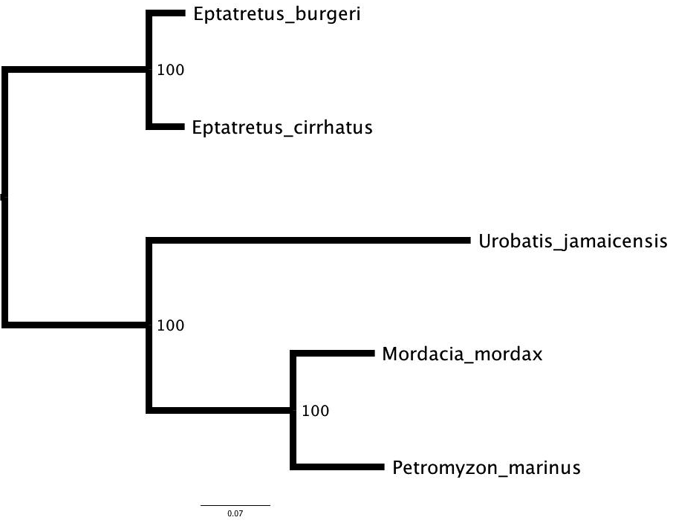
Results

Slide 31
Future directions
Outgroup :’(
Include more transcriptome data
Genome guided alignments
IQ-Tree for inferring phylogeny
Chapter?
Notes:
thought it’d be easy; lots of problem solving

Slide 32
Works Cited
Bardack, D. (1991). First fossil hagfish (Myxinoidea): a record from the Pennsylvanian of Illinois. Science, 254(5032), 701-703.
Delsuc, F., Philippe, H., Tsagkogeorga, G., Simion, P., Tilak, M. K., Turon, X., ... & Douzery, E. J. (2018). A phylogenomic framework and timescale for comparative studies of tunicates. BMC biology, 16(1), 39.
Dunn CW, Howison M, Zapata F. (2013). Agalma: an automated phylogenomics workflow. BMC Bioinformatics 14(1): 330. doi:10.1186/1471-2105-14-330
Kuraku, S. (2008). Insights into cyclostome phylogenomics: pre-2R or post-2R. Zoological science, 25(10), 960-969.
Kuraku, S. (2010). Palaeophylogenomics of the vertebrate ancestor—impact of hidden paralogy on hagfish and lamprey gene phylogeny.
McCauley, D. W., Docker, M. F., Whyard, S., & Li, W. (2015). Lampreys as diverse model organisms in the genomics era. BioScience, 65(11), 1046-1056.
Mele, C. (2017, July 14). Chain-Reaction Crash With Minor Injuries, Except for the Slime Eels. The New York Times. https://www.nytimes.com/2017/07/14/us/slime-eels-oregon.html
Miyashita, T., Coates, M. I., Farrar, R., Larson, P., Manning, P. L., Wogelius, R. A., ... & Currie, P. J. (2019). Hagfish from the Cretaceous Tethys Sea and a reconciliation of the morphological–molecular conflict in early vertebrate phylogeny. Proceedings of the National Academy of Sciences, 116(6), 2146-2151.
Smith, J. J., Antonacci, F., Eichler, E. E., & Amemiya, C. T. (2009). Programmed loss of millions of base pairs from a vertebrate genome. Proceedings of the National Academy of Sciences, 106(27), 11212-11217.
Smith, J. J., Kuraku, S., Holt, C., Sauka-Spengler, T., Jiang, N., Campbell, M. S., ... & Morgan, J. R. (2013). Sequencing of the sea lamprey (Petromyzon marinus) genome provides insights into vertebrate evolution. Nature genetics, 45(4), 415.
Smith, J. J., Timoshevskaya, N., Ye, C., Holt, C., Keinath, M. C., Parker, H. J., ... & Kaessmann, H. (2018). The sea lamprey germline genome provides insights into programmed genome rearrangement and vertebrate evolution. Nature genetics, 50(2), 270.
Suzuki, T., Ota, T., Fujiyama, A., & Kasahara, M. (2004). Construction of a bacterial artificial chromosome library from the inshore hagfish, Eptatretus burgeri: a resource for the analysis of the agnathan genome. Genes & genetic systems, 79(4), 251-253.

